Slide 1
NAFTA and Its Renegotiation
Alan V. Deardorff
University of Michigan
For presentation at Adult Learning Institute
Oakland Community College
April 24, 2018

Slide 2
Outline
NAFTA
  What it is
  What have been its effects
Renegotiation
  Timeline
  Issues
  Autos
  Prospects

Slide 3
Outline
NAFTA
  What it is
  What have been its effects
Renegotiation
  Timeline
  Issues
  Autos
  Prospects

Slide 4
NAFTA
North American Free Trade Agreement among US, Canada, Mexico
FTA =
  Zero tariffs on imports from partners
  Unchanged tariffs on imports from outside
  Rules of origin (ROOs) to qualify for zero tariffs

Slide 5
NAFTA
History
  Negotiated under George H.W. Bush
  Approved by Congress under Clinton
  Went into effect 1994
  Followed at end of 1994 by Peso Crisis
    Mexico’s currency fell by half
    Mexico plunged into recession

Slide 6
Outline
NAFTA
  What it is
  What have been its effects
Renegotiation
  Timeline
  Issues
  Autos
  Prospects

Slide 7
NAFTA Effects
Trade
  Grew massively across N. America
  US bilateral trade with Mexico became deficits: US imports > US exports

Slide 8
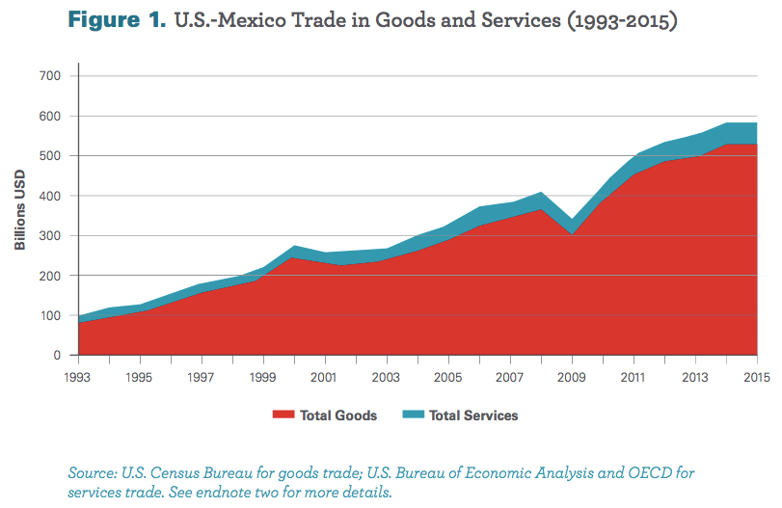
From: Wilson, Christopher, Growing Together: Economic Ties between the United States and Mexico, Wilson Center, March 2017.

Slide 9
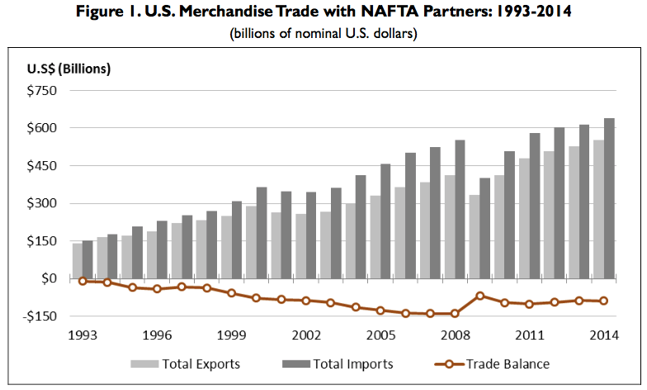
Source: Congressional Research Service (2015)

Slide 10
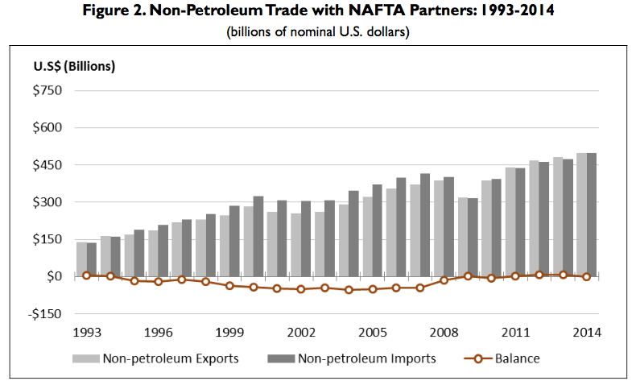
Source: Congressional Research Service (2015)

Slide 11
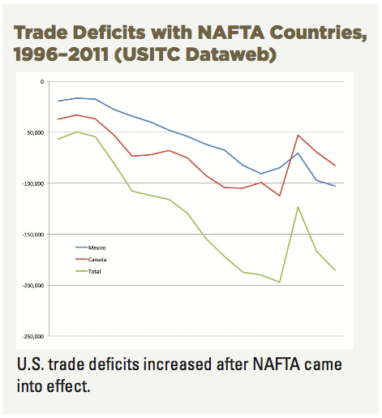
Source: AFL-CIO, “NAFTA at 20”

Slide 12
NAFTA Effects
Wages
  Fell in Mexico
  No effect on average in US

Slide 13
Real Wages Plummeted!
What Happened: Mexico
NAFTA
Peso Crisis

Slide 14
Real Wage: No Change
What Happened: U.S.
NAFTA
Peso Crisis

Slide 15
NAFTA Effects
Employment
  No effect on overall US employment or unemployment
  Pockets of disruption across US

Slide 16
Unemployment: No effect (or fell)
What Happened: U.S.
NAFTA
Peso Crisis

Slide 17
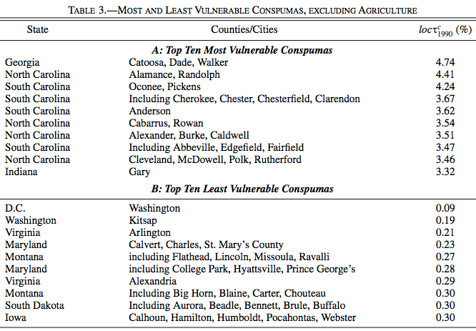
(Consistent Public-Use Microdata Areas)
Source: Hakobyan and McLaren (2016)

Slide 18
NAFTA Effects
Supply chains
  US manufacturing moved inputs to low-cost locations across N. America
  US firms became more competitive with firms abroad

Slide 19
NAFTA Effects
Consumers
  As always with freer trade, the ultimate beneficiaries are consumers
    Lower prices for
      Imported consumer goods
      Domestically produced goods and services that use cheaper imported inputs
    Greater variety of goods to choose from
  These gains are hard to measure
    One indicator may be the low rates of price inflation experienced under NAFTA

Slide 20
Outline
NAFTA
  What it is
  What have been its effects
Renegotiation
  Timeline
  Issues
  Autos
  Prospects

Slide 21
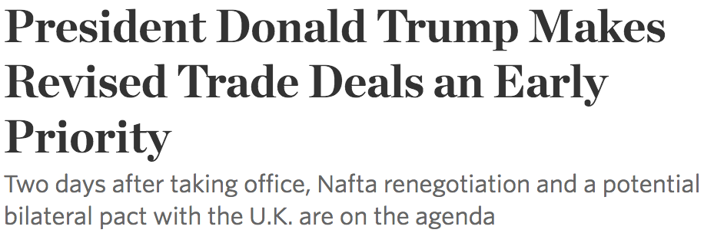
NAFTA Renegotiation
Donald Trump
  Trump opposed NAFTA as early as 1993
    “The Mexicans want it, and that doesn't sound good to me.”
  As candidate in 2016
    “The single worst trade deal ever approved in this country”
  After inauguration Jan 23, 2017

Slide 22
NAFTA Renegotiation
Donald Trump
  April 26: Threatened to pull out of NAFTA completely
  April 27: Decided not to, and to renegotiate instead
  May 18: Formally launched renegotiation

Slide 23
NAFTA Renegotiation
August 16, 2017: Negotiations began
  Round 1: Aug 16-20, Washington, DC
  Round 2: Sep 1-5, Mexico City
  Round 3: Sep 23-27, Ottawa
  Round 4: Oct 11-15, Washington, DC
  Round 5: Nov 17-21, Mexico City
  Round 6: Jan 23-28, Montreal
  Round 7: Feb 25 – Mar 5, Mexico City
  Round 8: Planned for Apr 8, Washington, DC, on hold
    “High-level” meetings happening instead
    Aim to finish by early May

Slide 24
Outline
NAFTA
  What it is
  What have been its effects
Renegotiation
  Timeline
  Issues
  Autos
  Prospects

Slide 25
Renegotiation Issues
Issues (US)
  Trade imbalances
  Reciprocal duty-free market access
  Rules of origin
  Regulations
  Services
  Digital trade
  ISDS
  State-owned enterprises
  Labor standards
  Chapter 19
  Procurement
  Currency manipulation
  Sunset clause

Slide 26
Renegotiation Issues
Other Issues (Canada)
  Gender rights
  Indigenous rights
  Freer movement of professionals
  Dairy & poultry
  Cultural exemptions

Slide 27
Renegotiation Issues
Other Issues (Mexico)
  Avoid increased US tariffs on Mexico’s exports (80% of Mexico’s exports are to the US)
  Anti-corruption
  Energy, financial services and telecommunications
  Guest worker program in US

Slide 28
Issues in More Detail
Trade imbalances
  The US top priority is to “Improve the U.S. trade balance and reduce the trade deficit with the NAFTA countries.”
  That is not something that can itself be written into the NAFTA agreement
  So the question will be which changes in the agreement might do this
  One possibility is a “trigger mechanism” that raises tariffs if goal of reducing deficit is not met
  Most economists agree that trade deficits
    Are not the result of trade policies
    Don’t mean deficit country is losing
    Result from spending more than income

Slide 29
Issues in More Detail
Rules of origin
  The TPP would have reduced the requirement for North American content in autos from 62.5% to below 50%.
  The new NAFTA will almost certainly increase this requirement for autos and other products, to 85%.
  The question will be: how much, and how disruptive will it be
  If too high, some producers will revert to sourcing from outside NAFTA
  Lighthizer wants “higher NAFTA content and substantial (50%) American content”.
    That would be unprecedented in an FTA
    That has now been dropped, in favor of other more complex requirements (e.g., % from high-wage labor)

Slide 30
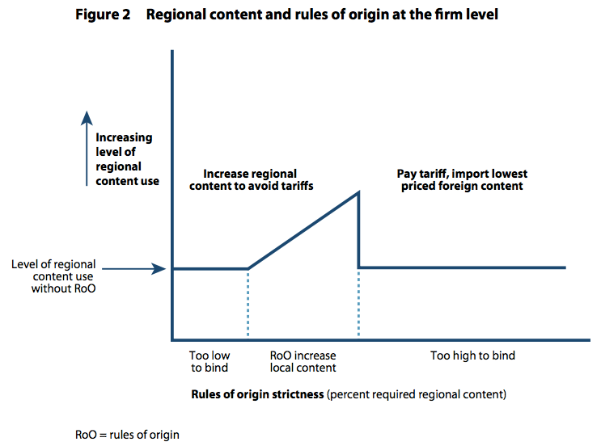
How Tighter Rules of Origin Can Increase Imports
From: Freund, Caroline, “Streamlining Rules of Origin,” Policy Brief 17-25, Peterson Institute for International Economics, June 2017.

Slide 31
Issues in More Detail
ISDS = Investor-State Dispute Settlement (Chapter 11 of NAFTA)
  U.S. has so far never lost an ISDS case
  Trump seems to want it retained (as do US large corporations)
  USTR wants to eliminate it (as does the AFL/CIO)
  Canada & Mexico want to keep it, and may just allow US to “opt out”

Slide 32
Issues in More Detail
Chapter 19
  This now allows NAFTA countries an appeal against AD & CVD actions
  Canada insists on keeping it
  US wants it removed
  You can see why from the data below

Slide 33
Issues in More Detail

Slide 34
Issues in More Detail

Slide 35
Issues in More Detail
Dairy & poultry
  Canada wants to keep its “supply management system for dairy and poultry”
    Supply management allows farmers to act collectively to manage supply and price
  Canada has a 270% tariff on dairy imports (with a small quota tariff-free)
  This was exempted from liberalization in NAFTA

Slide 36
Issues in More Detail
Sunset Clause
  US wants the renegotiated NAFTA to expire after some period (5 years)
  To be renewed only with another renegotiation
  This would undermine its usefulness to investors, which may be the point

Slide 37
Outline
NAFTA
  What it is
  What have been its effects
Renegotiation
  Timeline
  Issues
  Autos
  Prospects

Slide 38
NAFTA and the Auto Sector
Effects of NAFTA
  Supply chains extended across NAFTA countries
    True in much of manufacturing, but especially in autos
  Producers became more competitive with producers outside NAFTA
  Some plants closed or moved, and US jobs were lost

Slide 39
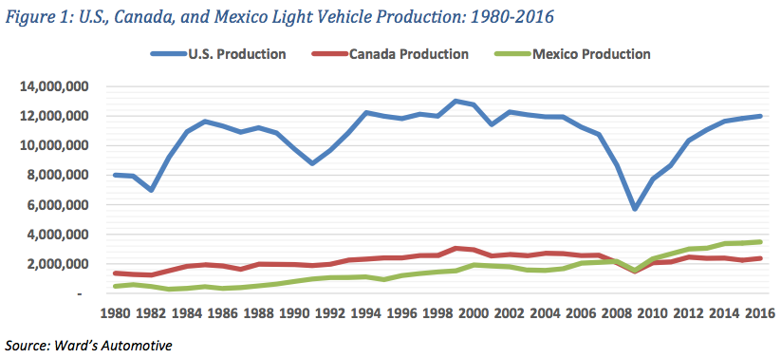
NAFTA and the Auto Sector
From: CAR, “NAFTA Briefing,” January 2017

Slide 40
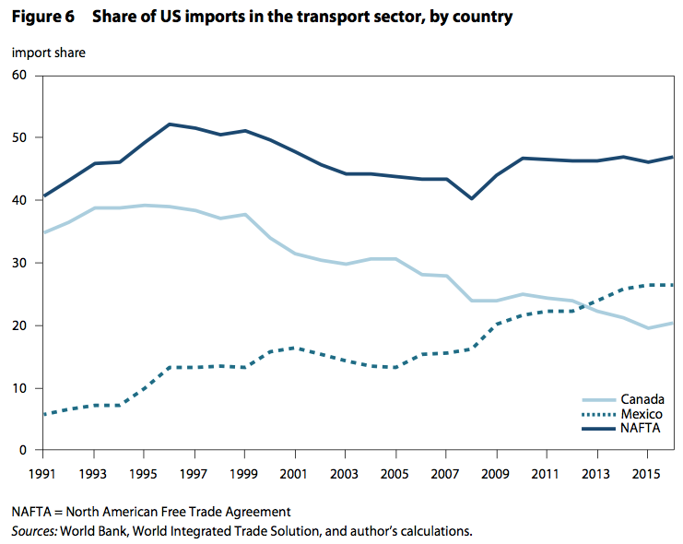
NAFTA and the Auto Sector
From: Freund, Caroline, “Streamlining Rules of Origin,” Policy Brief 17-25, Peterson Institute for International Economics, June 2017.

Slide 41
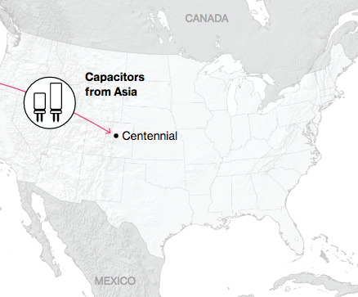
NAFTA and the Auto Supply Chain
Black, Diamond, and Merrill, “One Tiny Widget’s Dizzying Journey Shows Just How Critical Nafta Has Become,” Bloomberg, February 2, 2017.

Slide 42
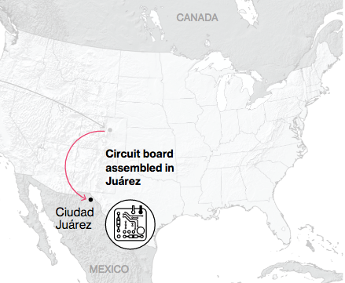
NAFTA and the Auto Supply Chain
Black, Diamond, and Merrill, “One Tiny Widget’s Dizzying Journey Shows Just How Critical Nafta Has Become,” Bloomberg, February 2, 2017.

Slide 43
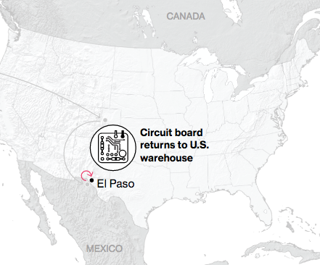
NAFTA and the Auto Supply Chain
Black, Diamond, and Merrill, “One Tiny Widget’s Dizzying Journey Shows Just How Critical Nafta Has Become,” Bloomberg, February 2, 2017.

Slide 44
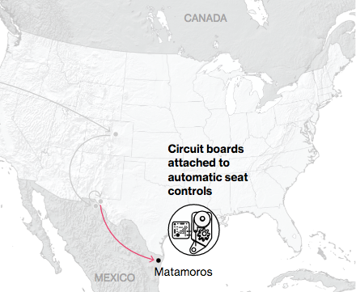
NAFTA and the Auto Supply Chain
Black, Diamond, and Merrill, “One Tiny Widget’s Dizzying Journey Shows Just How Critical Nafta Has Become,” Bloomberg, February 2, 2017.

Slide 45
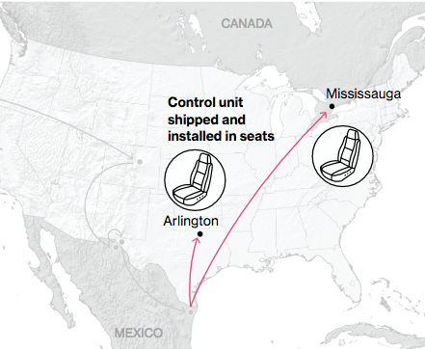
NAFTA and the Auto Supply Chain
Black, Diamond, and Merrill, “One Tiny Widget’s Dizzying Journey Shows Just How Critical Nafta Has Become,” Bloomberg, February 2, 2017.

Slide 46
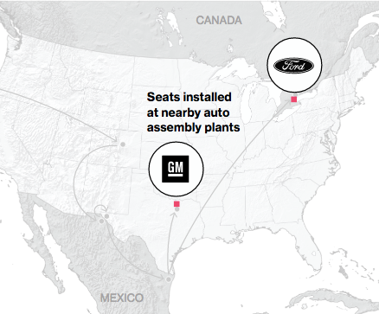
NAFTA and the Auto Supply Chain
Black, Diamond, and Merrill, “One Tiny Widget’s Dizzying Journey Shows Just How Critical Nafta Has Become,” Bloomberg, February 2, 2017.

Slide 47
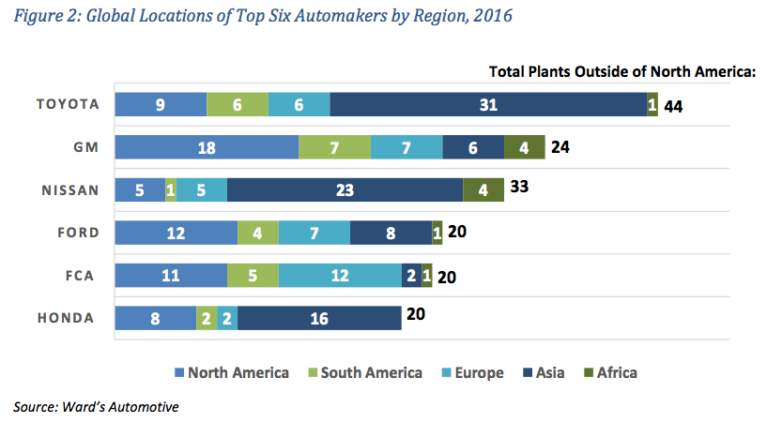
NAFTA and the Auto Sector
From: CAR, “NAFTA Briefing,” January 2017

Slide 48
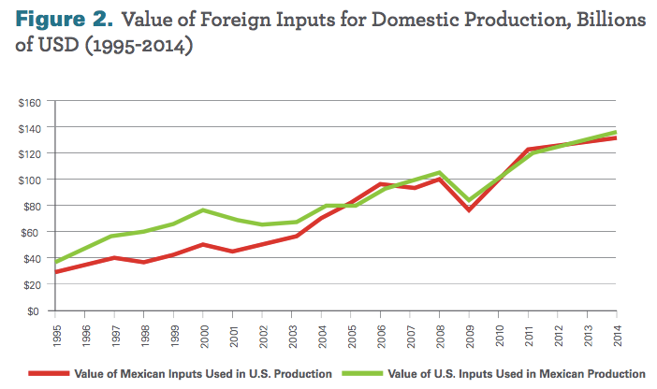
NAFTA and Supply Chains
From: Wilson, Christopher, Growing Together: Economic Ties between the United States and Mexico, Wilson Center, March 2017.

Slide 49
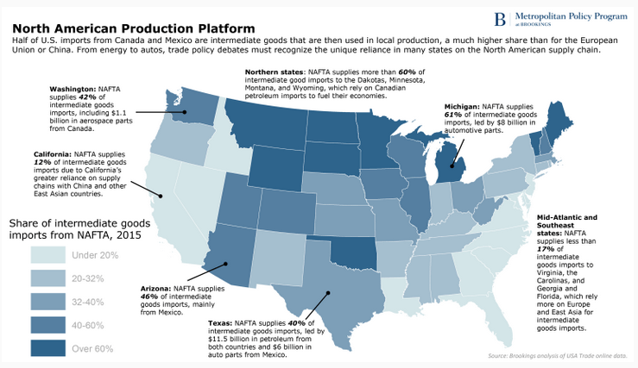
NAFTA and Supply Chains
From: Parilla, Joseph, “How US states rely on the NAFTA supply chain,” The Avenue, blog, Brookings, March 30, 2017.

Slide 50
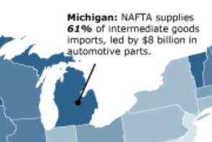
NAFTA and Supply Chains
From: Parilla, Joseph, “How US states rely on the NAFTA supply chain,” The Avenue, blog, Brookings, March 30, 2017.

Slide 51
NAFTA and the Auto Sector
Effects of NAFTA Renegotiation or Failure
    Tightening of Rules of Origin
    Returning to MFN tariffs
  Inputs that now cross borders will become subject to tariffs
  Along supply chains, tariffs will be levied on tariffs
  Some inputs will be re-sourced to within NAFTA or US, at higher prices
  Others will be re-sourced to Asia/Europe, also at higher prices, as tariff preference is lost or foregone

Slide 52
NAFTA and the Auto Sector
Effects of NAFTA Renegotiation or Failure
  All options raise costs
    Reducing consumer welfare (higher prices for cars)
    Reducing US producers’ competitiveness with producers outside NAFTA
    Some producers may, eventually, relocate outside NAFTA
  Some options increase employment in US, others reduce it
  Trade imbalance
    with Mexico likely falls, but
    with rest of world will likely rise

Slide 53
Outline
NAFTA
  What it is
  What have been its effects
Renegotiation
  Timeline
  Issues
  Autos
  Prospects

Slide 54
Renegotiation Prospects
US has included demands that some say are “poison pills”
  Demands that they know others cannot accept
  Is the purpose to get a better outcome (as they view it) for US?
  Or is the purpose to justify later pulling out of NAFTA?

Slide 55
Renegotiation Prospects
US is most eager to complete a deal before
  TPA (Trade Promotion Authority = “Fast Track”) expires (not likely to expire)
  Mexico’s presidential election, July 1, 2018
  US midterm election season heats up

Slide 56
Renegotiation Prospects
Canada and Mexico have added incentive to agree:
  Returning to prior tariffs will hurt them more than US
  Trump exempted them from his metals tariffs conditional on NAFTA agreement
    25% on steel
    10% on aluminum
      Canada is largest aluminum supplier to US and 2nd largest of steel after EU
      Mexico is 4th largest supplier of steel

Slide 57
Renegotiation Prospects
Renegotiation was briefly complicated by Trump’s stated desire to re-enter TPP, but that changed
If deal is reached, will Trump approve?
If not, will he pull out of NAFTA completely?

